Slide 1
CIS CONTROL 16: ACCOUNT MONITORING & CONTROL-II
ACCOUNT MONITORING & CONTROL

Slide 2
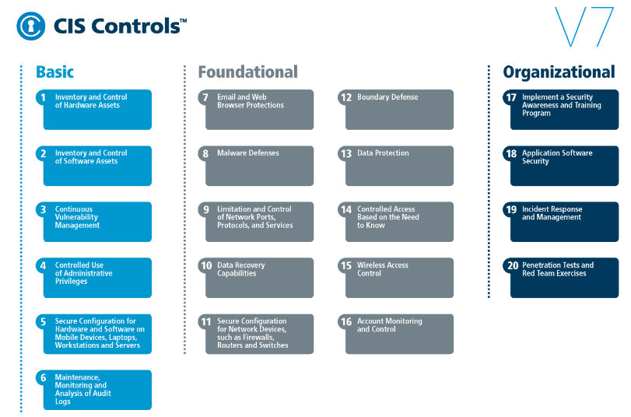
CIS CONTROL 16: ACCOUNT MONITORING & CONTROL-II
https://www.cisecurity.org/controls/

Slide 3
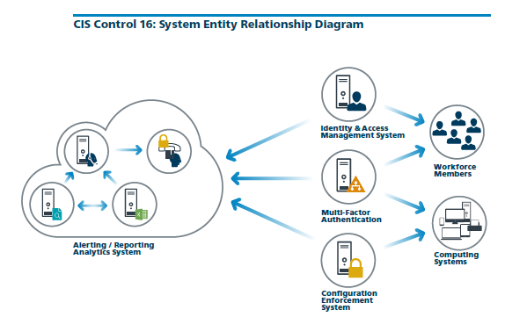
CIS CONTROL 16: ACCOUNT MONITORING & CONTROL-II
https://www.cisecurity.org/controls/

Slide 4
CIS CONTROL 16: ACCOUNT MONITORING & CONTROL-II
16.5: Encrypt Transmittal of Username and Authentication Credentials
Ensure that all account usernames and authentication credentials are transmitted across networks using encrypted channels.

Slide 5
CIS CONTROL 16: ACCOUNT MONITORING & CONTROL-II
16.6: Maintain an Inventory of Accounts
Maintain an inventory of all accounts organized by authentication system.

Slide 6
CIS CONTROL 16: ACCOUNT MONITORING & CONTROL-II
16.7: Establish Process for Revoking Access
Establish and follow an automated process for revoking system access by disabling accounts immediately upon termination or change of responsibilities of an employee or contractor . Disabling these accounts, instead of…

Slide 7
CIS CONTROL 16: ACCOUNT MONITORING & CONTROL-II
16.7: Establish Process for Revoking Access
…deleting accounts, allows preservation of audit trails.

Slide 8
CIS CONTROL 16: ACCOUNT MONITORING & CONTROL-II
16.8: Disable Any Unassociated Accounts
Disable any account that cannot be associated with a business process or business owner.

